Slide 1

CE Display Device Driver Accelerator

Slide 2
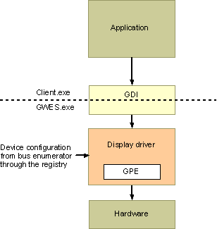
WinCE Display Driver
gwes.exe : Graphics, Windowing and Events Subsystem
ddi.dll : display device driver interface
GPE (Graphics Primitive Engine base class library) : device-independent bitmap (DIB) driver.
  the emulation library
  ClearType
  antialiasing
  gradient fill

Slide 3
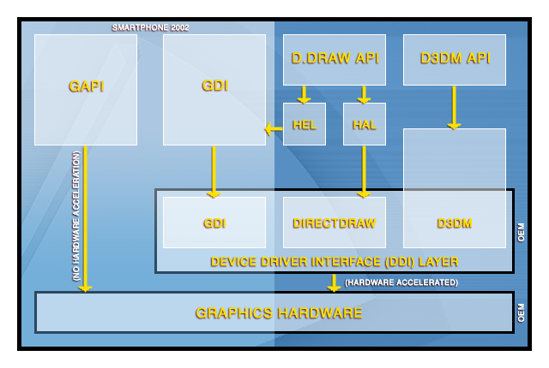
Video Architecture

Slide 4
DDI Functions
DisplayInit : display 정보를 registry에서 찾음.
DrvAnyBlt : bit block transfer를 수행. 확장 및 투명도 적용.
DrvBitBlt : 일반적인 bit block transfer를 수행.
DrvCopyBits : copy between raster surface and GDI standard bitmap.
DrvCreateDeviceBitmap : Bitmap file 생성 및 관리.
DrvDeleteDeviceBitmap : Bitmap file 삭제.
DrvDisableDriver : display driver를 disable함.
DrvDisablePDEV : disable a particular display driver.
DrvDisableSurface : disable a particular drawing surface.
DrvEnableDriver : return DDI function pointer to GDI.
DrvEnablePDEV : return a PDEV structure to GDI.
DrvEnableSurface : create a drawing surface.
DrvEndDoc : 인쇄종료 정보 전달.
DrvEscape : 사용 불가능한 device로부터 정보 검색.

Slide 5
DDI Functions
DrvFillPath : 지정한 brush로 채워 넣음.
DrvGetMasks : color mask를 읽어옴.
DrvGetModes : 지원하는 display mode list 정보를 return.
DrvGradientFill : GDI의 bitmap을 display device가 나타낼 수 있는 bitmap으로 변환.
DrvMovePointer : pointer를 이동.
DrvPaint : 지정한 brush로 특정영역을 칠함.
DrvPowerHandler : POWER_UP, POWER_DOWN 명령.
DrvRealizeBrush : brush를 생성.
DrvRealizeColor : RGB color를 display device가 나타낼 수 있는 가장 유사한 color로 mapping.
DrvSetPalette : palette을 설정.
DrvSetPointerShape : pointer를 새로운 shape로 설정하고, display를 update.
DrvStartDoc : Document 인쇄에 필요한 정보 전달.

Slide 6
DDI Functions
DrvStartPage : 새로운 page를 인쇄하기 위한 정보 전달.
DrvStrokePath : drawing path(line, curve 등)를 만듬.
DrvStrokeAndFillPath : drawing path를 만들고, 안을 채움.
DrvTransparentBlt : 투명도를 적용하여 bit block transfer를 수행.
DrvUnrealizeColor : display device의 color를 RGB color로 변환.

Slide 7
GPE classes
GPE
  GPE::AllocSurface : surface pixel 용으로 storage에 영역할당.
  GPE::BltComplete : blit 동작을 완료시킴.
  GPE::BltPrepare : blit에 필요한 function을 지정.
  GPE::GetModeInfo : 요구된 mode에 대한 정보를 알림.
  GPE::Line : Line을 그림.
  GPE::MovePointer : cursor의 위치를 이동.
  GPE::NumModes : 지원 가능한 mode의 개수를 알림.
  GPE::SetMode : display mode를 설정.
  GPE::SetPointerShape : pointer의 shape를 지정.
GPESurf
  GPESurf::GPESurf : system-memory surface를 만들고, storage에 영역할당.
  GPESurf::Init : GPESurf object를 초기화.
Node2D
ColorConverter
GPEVGA

Slide 8
Display Driver Extension
Bit Block Transfers Acceleration
Line Drawing Acceleration
  Fill Path
  Paint
  Stroke drawing path (line, curve, etc)
ClearType : Font의 거친 부분을 완화.
Anti-aliased Support
Multiple Screen Driver Support : large screen or multi screens.
Screen Rotation

Slide 9
Direct Draw
GDI를 거치지 않고 hardware abstraction layer (HAL)의 function을 direct로 access.
smoother animation, display-intensive software (runs faster and avoids screen flicker )
DirectDraw hardware abstraction layer (DDHAL)

Slide 10
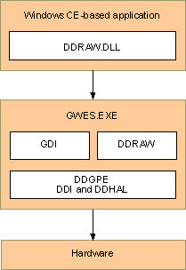
Direct Draw Arch.
DirectDraw Graphics Primitive Engine (DDGPE) : combine GDI/DDI and DDRAW/DDHAL
DDGPE : extensions of the existing GPE classes

Slide 11
DDHAL Function
DirectDraw Callback Function
  CanCreateSurface : Surface생성가능여부판단.
  CreatePalette : DirectDrawPalette object 생성.
  CreateSurface : DirectDrawSurface object 생성.
  DestroyDriver : Destroy DirectDrawDriver.
  FlipToGDISurface : GDI가 사용할 primary surface로 지정.
  GetScanLine : 현재의 display scan line 정보를 얻음.
  SetColorKey : color key 값들 설정.
  SetExclusiveMode : DirectDraw object의 특성을 exclusive mode로 전환.
  SetMode : display mode를 설정.
  WaitForVerticalBlank : vertical blank 기간을 기다림.

Slide 12
DDHAL Function
DirectDrawSurface Callback Function
  AddAttachedSurface : surface를 다른 surface에 붙임.
  Blt : Bit Block Transfer를 수행.
  DestroySurface : 지정한 surface를 삭제.
  Flip : front surface와 back surface를 바꾼다.
  GetBltStatus : Blt의 현 상태를 확인.
  GetFlipStatus : Flip 작업의 진행상황을 확인.
  Lock : 메모리의 특정영역을 surface용으로 고정.
  SetClipList : 특정 surface를 위한 clip list를 설정.
  SetOverlayPosition : overlay surface의 좌표를 설정.
  SetPalette : 특정 surface의 palette을 설정.
  Unlock : 특정 surface를 unlock
  UpdateOverlay : overlay surface의 시각효과를 수정.

Slide 13
DDHAL Function
DirectDrawPalette Callback function
  DestroyPalette : 특정 palette을 삭제.
  SetEntries : palette의 구성을 설정.
DirectDraw Driver Extension callback Function
  GetDriverInfo : driver callback의 pointer등의 정보를 얻음.
Miscellaneous Callback Functions
  GetSysmemBltStatus : 비동기 DMA의 동작상태를 조회.
Color Control Callback Functions
  HalColorControl : luminance and brightness를 설정.

Slide 14
DDHAL Function
Video Port Extension Callback Functions
  CanCreateVideoPort : video port를 생성할 수 있는지 알려줌.
  CreateVideoPort : video port를 생성.
  DestroyVideoPort : video port를 삭제.
  FlipVideoPort : video port에 새로운 surface를 출력.
  GetVideoPortBandwidth : 필요한 bandwidth를 알려줌.
  GetVideoPortConnectInfo : 특정 video port가 지원하는 연결조합을 알려줌.
  GetVideoPortField : even field or odd field.
  GetVideoPortFlipStatus : video port를 flip한 뒤 Vsync의 상태를 전달.
  GetVideoPortInputFormats
  GetVideoPortLine : 현재의 line번호를 알려줌.
  GetVideoSignalStatus : video port가 signal을 정상적으로 받는지 알려줌.
  HalColorControl : video port의 color data를 설정하거나 읽음.
  UpdateVideoPort : video port를 시작, 정지, 변경시킨다.
  WaitForVideoPortSync : vsync 등의 신호의 시작이나 끝을 기다림.

Slide 15
DDGPE Classes
DDGPE class
  DDGPE::AllocSurface : 새로운 surface용 memory를 할당.
  DDGPE::AllocVideoSurface : DDGPESurf object를 생성.
  DDGPE::BltExpanded : GPE blit를 수행.
  DDGPE::BltPrepare : GPE::BltPrepare의 확장.
  DDGPE::DetectMode : 지원되는 display mode를 결정.
  DDGPE::DetectPixelFormat : EGPEFormat → EDDGPEPixelFormat으로 변환.
  DDGPE::GetDriverData : driver data의 pointer를 return.
  DDGPE::GetDriverGUID : driver specific globally unique identifier를 읽음.
  DDGPE::GetModeInfoEx : extended mode 정보를 읽음.
  DDGPE::GetPhysicalModeId : display의 현재 모드로 회복.
  DDGPE::InDisplay : scanline(CRT)이 display 영역내인지 아닌지 판별.
  DDGPE::PerformBlt : blit를 수행.
  DDGPE::SetDriverData : DDGPE object에 driver에 특화된 data 저장.
  DDGPE::SetDriverGUID : 특정 object에 GUID를 적용.
  DDGPE::SetMode : display mode를 변경.
  DDGPE::SetVisibleSurface : 특정 GPE surface를 display시킴.
  DDGPE::WrapSurface : DDGPESurf-based object를 생성.

Slide 16
DDGPE Classes
DDGPESurf class
  DDGPESurf::AlignedWidth
  DDGPESurf::Bpp : 현재 surface의 bit per pixel을 설정.
  DDGPESurf::ColorKey : 현재 surface의 color key를 읽음.
  DDGPESurf::ColorKeyHigh : 사용하고 있는 가장 큰 color key 값을 정정.
  DDGPESurf::ColorKeyLow : 사용하고 있는 가장 작은 color key 값을 정정.
  DDGPESurf::ColorKeyMask : color key mask값을 정정.
  DDGPESurf::Constructors
  DDGPESurf::DeleteSurface
  DDGPESurf::HasAlpha
  DDGPESurf::Init
  DDGPESurf::GetDDGPESurf
  DDGPESurf::GetDirectDrawSurface

Slide 17
DDGPE Classes
DDGPESurf class
  DDGPESurf::GetDriverData
  DDGPESurf::GetDriverGUID
  DDGPESurf::PixelFormat
  DDGPESurf::SetColorKey
  DDGPESurf::SetColorKeyHigh
  DDGPESurf::SetColorKeyLow
  DDGPESurf::SetColorKeyMask
  DDGPESurf::SetDirectDrawSurface
  DDGPESurf::SetDDGPESurf
  DDGPESurf::SetDriverData
  DDGPESurf::SetDriverGUID

Slide 18
DDGPE Classes
SurfaceHeap class
  SurfaceHeap::Address
  SurfaceHeap::Alloc
  SurfaceHeap::Available
  SurfaceHeap::Constructors
  SurfaceHeap::Free
  SurfaceHeap::NodeSize
  SurfaceHeap::Size

Slide 19
Direct Draw Extension
DDHAL
  DDGPE
    AllocSurface : allocate many different types of surfaces→ surface의 개수 제한에서 벗어남.
    GetModeInfoEx : returns DDGPE's extended mode information.
    SetVisibleSurface : change the display to show the selected surface. DirectDraw surface flips을 지원할 경우 필요.
  DDGPESurf
    HasAlpha : alpha channel의 지원 여부를 알려줌.
  Use of SurfaceHeap

Slide 20
Direct 3D Mobile
Direct 3D Mobile Driver Functions
  D3DM_CreateContext : rendering context 생성.
  D3DM_CreateSurface : surface 생성.
  D3DM_DestroyContext : rendering context 삭제.
  D3DM_DestroySurface : surface 삭제.
  D3DM_DrawPrimitive : contents를 display하기 위해 command buffer에 전달.
  D3DM_GetAdapterInfo : graphic device의 정보를 읽음.
  D3DM_GetInfo : 추가정보를 요구.
  D3DM_Initialize : DLL의 point 전달.
  D3DM_LockSurface
  D3DM_ResourceManager : driver가 관리하는 memory pool에서 action을 수행.
  D3DM_UnLockSurface : lock을 제거.
  D3DM_ValidateDevice : texture의 조합방법의 개수를 알림.

Slide 21
Direct 3D Mobile Structure
D3DM_CLEAR | Contains the contents of the D3DMOP_CLEAR command token, which instructs the driver to clear a render target, depth buffer, or index buffer.
D3DM_COLORFILL | Contains the contents of the D3DMOP_COLORFILL command token, which instructs the driver to fill a rectangle on a surface with a color.
D3DM_COMMAND | Contains the header data for a single command token in a command buffer.
D3DM_COPYRECT | Contains the contents of the D3DMOP_COPYRECT command token, which instructs the driver to copy pixel data from one surface to another.
D3DM_CREATECONTEXT_DATA | Contains information about a rendering context.
D3DM_CREATELIGHT | Contains the contents of the D3DMOP_CREATELIGHT command token, which instructs the driver to create a light and assign an index number to it.
D3DM_CREATEPALETTE | Contains the contents of the D3DMOP_CREATEPALETTE command token, which instructs the driver to create a palette and assign an index number to it.
D3DM_CREATESURFACE_DATA | Contains data describing the properties of a surface that the Direct3D Mobile driver should create.
D3DM_DESTROYCONTEXT_DATA | Identifies a rendering context that the driver should destroy.
D3DM_DESTROYSURFACE_DATA | Identifies a surface that should be freed.
D3DM_DRAWINDEXEDPRIMITIVE | Contains the contents of the D3DMOP_DRAWINDEXEDPRIMITIVE command token, which instructs the driver to draw a primitive using the current driver state and indices from the current index buffer.
D3DM_DRAWPRIMITIVE | Contains the contents of the D3DMOP_DRAWPRIMITIVE command token, which instructs the driver to draw primitives using the current driver state and vertices from the current index buffer.
D3DM_DRAWPRIMITIVE_DATA | Describes the properties of a command buffer.
D3DM_GETADAPTERINFO_DATA | Describes the standard properties of a graphics device.
D3DM_GETINFO_DATA | Describes a request for additional information from the driver beyond what it already provides with D3DM_GETADAPTERINFO_DATA.

Slide 22
Direct 3D Mobile Structure
D3DM_INDEXBUFFER | Contains the contents of the D3DMOP_INDEXBUFFER command token, which instructs the driver to change the current index buffer to a new one.
D3DM_INITIALIZE_DATA | Used to communicate the driver's support routines to the Direct3D Mobile middleware.
D3DM_LOCKSURFACE_DATA | Describes the properties of a surface lock requested by the Direct3D Mobile middleware.
D3DM_MATERIAL | Contains the contents of the D3DMOP_MATERIAL command token, which instructs the driver to update the current material properties.
D3DM_PRESENT | Contains the contents of the D3DMOP_PRESENT command token, which informs the driver that the current surface is complete and must be rendered to the screen.
D3DM_PROCESSVERTICES | Contains the contents of the D3DMOP_PROCESSVERTICES command token (see D3DM_OPERATION), which informs the driver that it should transform and light a series of vertices based on the current texture and lighting states.
D3DM_RENDERSTATE | Contains the contents of the D3DMOP_RENDERSTATE command token, which informs the driver that it must change one of its render states.
D3DM_RENDERTARGET | Contains the contents of the D3DMOP_RENDERTARGET command token, which informs the driver that it must switch its current render target or depth and stencil buffer.
D3DM_RESOURCEMANAGER_DATA | Provides data that describes actions that the driver should perform on its managed memory pool.
D3DM_SETLIGHT | Contains the contents of the D3DMOP_SETLIGHT command token, which is used to activate or deactivate a light.
D3DM_SETLIGHT_WITHDATA | Contains the contents of a D3DMOP_SETLIGHT command token, which is used to provide a full light description for a light and activate or deactivate that light.

Slide 23
Direct 3D Mobile Structure
D3DM_SETPALETTE | Contains the contents of a D3DMOP_SETPALETTE command token, which is used to activate a palette.
D3DM_SETPALETTE_WITHENTRIES | Contains the contents of a D3DMOP_SETPALETTE command token, which is used to define a palette.
D3DM_STRETCHRECT | Contains the contents of the D3DMOP_STRETCHRECT command token, which informs the driver that it should copy pixels from one surface to another and, if necessary, performing a stretch operation in the process.
D3DM_TEXTURESTAGESTATE | Contains the contents of the D3DMOP_TEXTURESTAGESTATE command token, which informs the driver that it should set a new texture stage state value.
D3DM_TRANSFORM | Contains the contents of the D3DMOP_TRANSFORM command token, which informs the driver that it should change one of the transformation matrices.
D3DM_UNLOCKSURFACE_DATA | Describes a surface that is to be unlocked by the driver.
D3DM_VALIDATEDEVICE_DATA | Used in calls to D3DM_ValidateDevice to record the number of passes the driver will need based on the current texture state.
D3DM_VERTEXBUFFER | Contains the contents of the D3DMOP_VERTEXBUFFER command token, which informs the driver that it should change the current vertex buffer.
D3DM_VIEWPORT | Contains the contents of the D3DMOP_VIEWPORT command token, which informs the driver that it should change the current viewport transformation.
D3DMDEVICEFORMAT | Describes the properties of a format that the driver supports for a Direct3D Mobile resource.
D3DMTEXTURE_DESC | Describes levels of a texture map.

Slide 24
참고

Slide 25
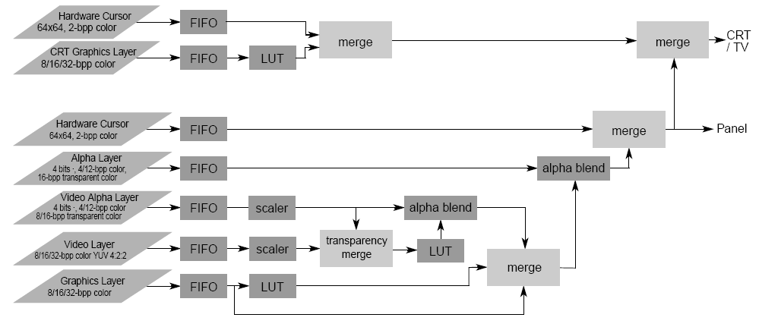
SM501
Video Layers and Data Processing

Slide 26
Future
Hardware Accelerated Text
Blt Generator – ship for other CPUs using CDPs
Continue to evangelize our PQD Best Practices to 3rd parties using our specifications
Continued enhancements to CETK for guaranteed best drivers

Slide 27
ClearType
Supports Color on Color
Available to application, as well as system wide setting
Uses existing Win 32 API
Contrast awareness
  ClearType to adapt based on changes in contrast settings
Supported on 8, 16, 24, 32 bpp display devices
Supported on a request by request basis
  CreateFontIndirect ( … );
  LOGFONT Changes
    CLEARTYPE_QUALITY
    CLEARTYPE_COMPAT_QUALITY
Supported system wide through registry settings,
  HKEY_LOCAL_MACHINE\System\GDI

